Slide 1
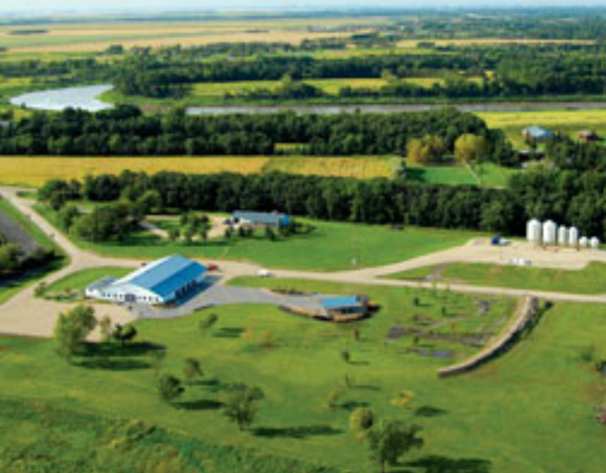
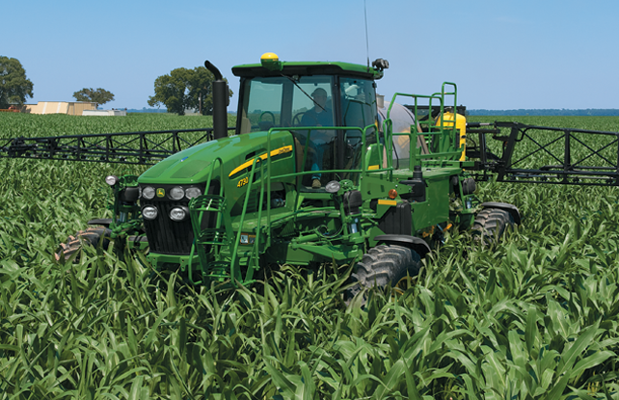
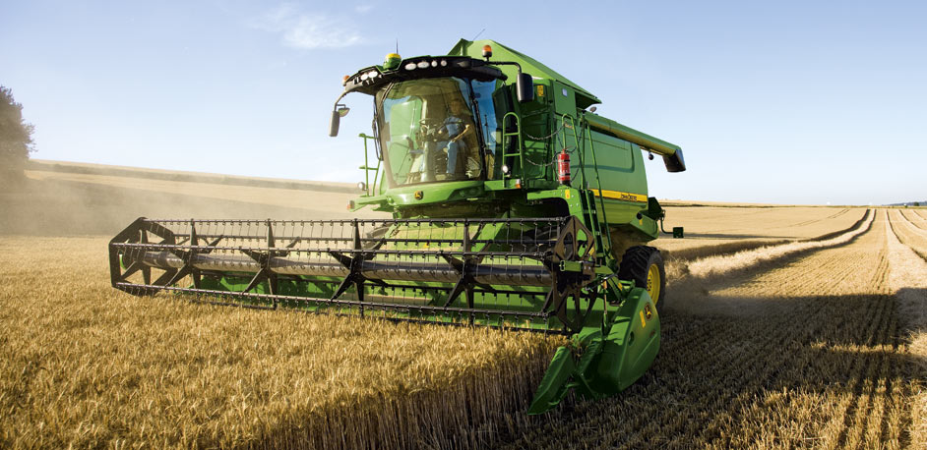
Winnipeg, MB / June 22-26, 2014
LEARN WHAT’S NEW IN CONSERVATION AGRICULTURE

Slide 2
WHO WILL ATTEND?
700
FARMERS
RESEARCHERS GOVERNMENT &
INDUSTRY LEADERS
GLOBAL CONFERENCE
50% GROWERS
• Evenly split between USA and Canada
50% KEY STAKEHOLDERS
• Researchers
• Government
• Industry

Slide 3
GROW MORE WITH LESS

Slide 4
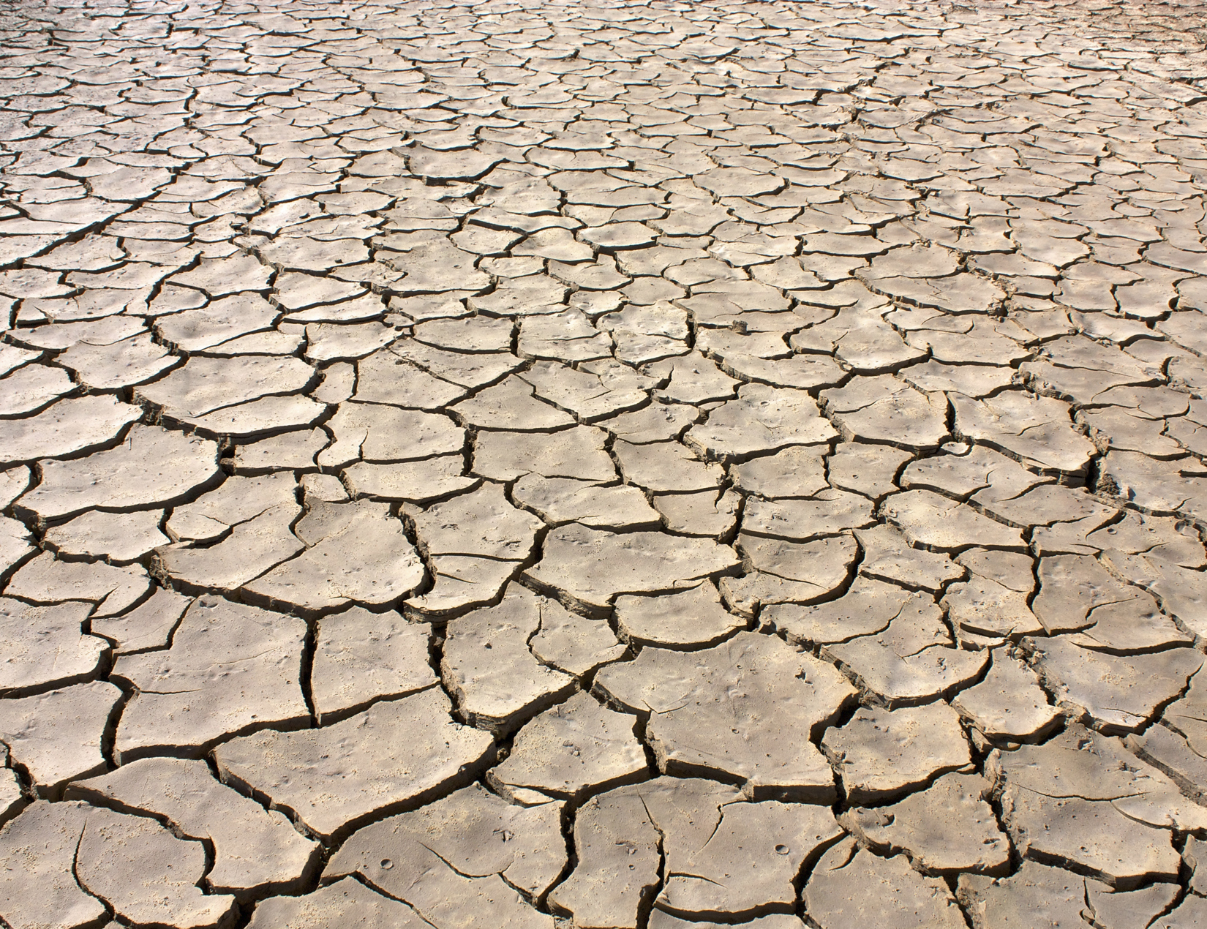
WEATHERPROOF YOUR CROP

Slide 5
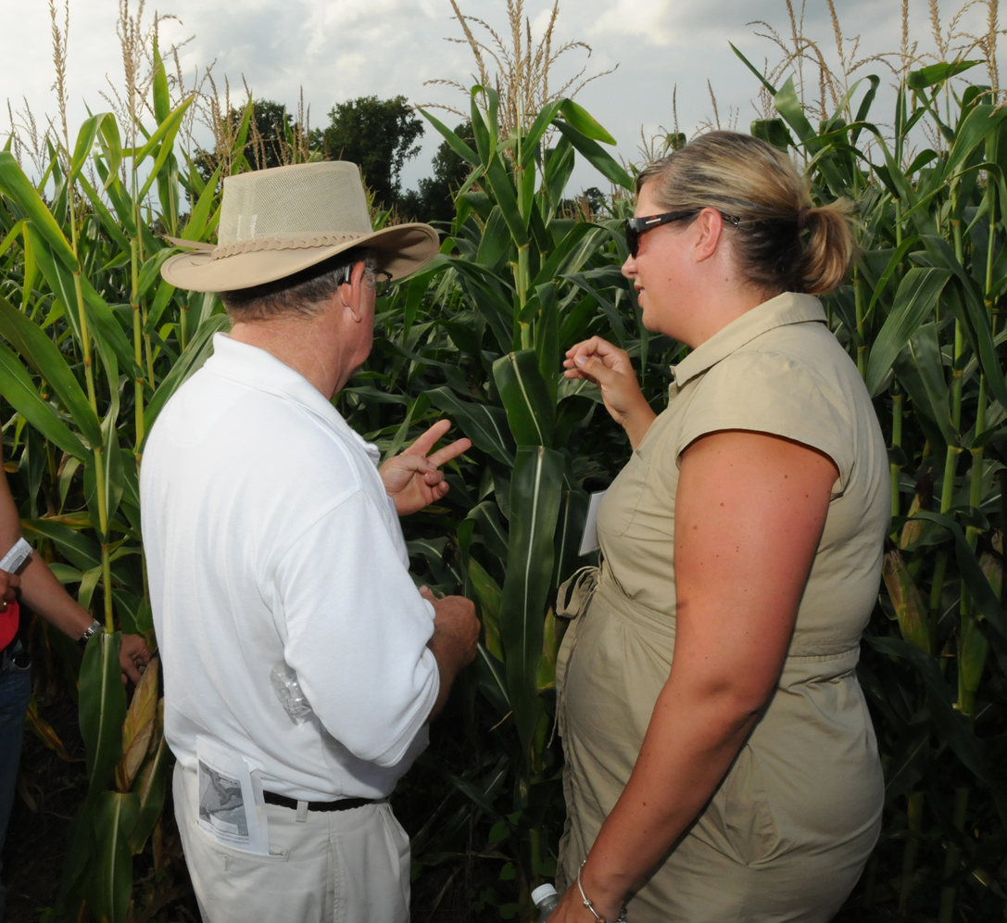
INNOVATE & ADOPT

Slide 6
TOPICS
GROWING MORE WITH LESS
= Sustainable Intensification
WEATHERPROOFING AGRICULTURE
= Climate Resilient Systems
INCREASING ADOPTION THROUGH
INNOVATION
= Knowledge sharing
= Faster implementation

Slide 7
WHAT’S NEW?
TECHNOLOGY ENHANCES
THE EXPERIENCE
• Pre-meeting promotion online
• Crowdsourcing
• Instant feedback via “clickers”
• Meeting app
• Multi-channel support from media partners

Slide 8
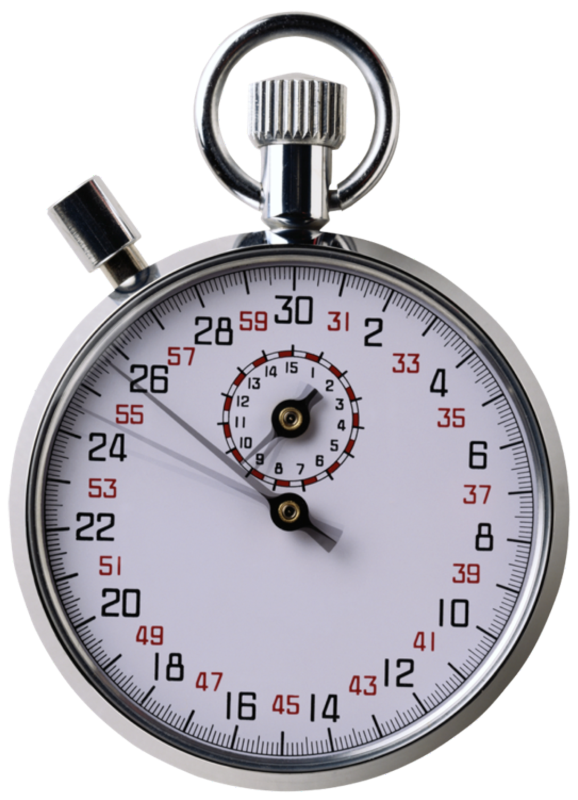
WHAT’S NEW?
RAPID FIRE 15-MINUTE
PRESENTATION FORMAT
• Faster pace
• More new ideas showcased
• Focused on delivering value to attendees
• Poster session “speed dating”

Slide 9
WHAT’S NEW?
ENGAGING GROWERS
• Comprehensive communications outreach via media partners
• Field-ready conservation practices
• Expanded networking opportunities
• Quality time with peers
• Lunch & learn table discussions with experts

Slide 10
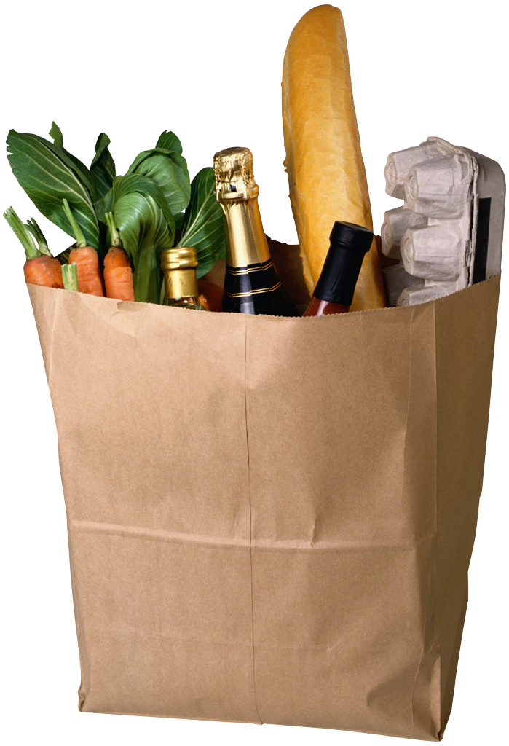
WHAT’S NEW?
FARM TO TABLE SUSTAINABILITY
• Industry panel presenting corporate sustainability initiatives and goals to growers
• Dialogue on implementing sustainable practices with growers
• Opportunities for cooperation

Slide 11
SPONSORSHIP LEVEL STRUCTURE
Level* | Exclusive Recognition | Complimentary Registrations | Discounted Grower Admission | Amount
Platinum | Lunch, Dinner, or Reception | 5 | 50 persons | $50,000
Gold | Breakfast or Break | 3 | 40 persons | $30,000
Silver | Shared Break | 2 | 30 persons | $15,000
Bronze | N/A | 1 | 10 persons | $5,000
*Details for the sponsorship levels are being developed.

